Slide 1
Testing DOM Interaction and Routing Components

Slide 2

Triggering events
Interacting with input boxes Routing
Agenda
ActivatedRoute
RouterLink

Slide 3
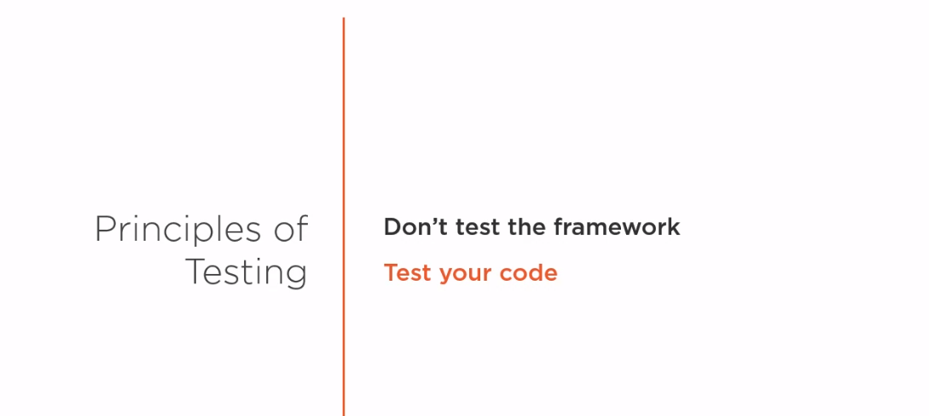

Slide 4
Events
Summary
Trigger on DOM node
Emit from child
Input elements RouterLink

